Slide 1
Canada
Andrew & Shayne

Slide 2
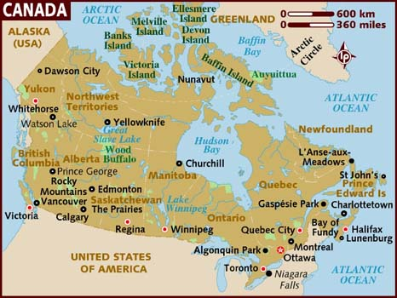
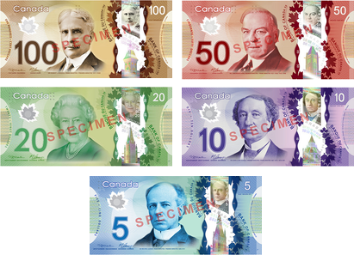
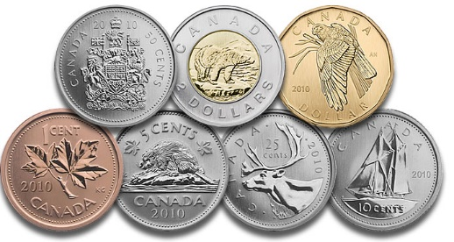
Introduction

Slide 3
Exchange Rates
Canadian dollar

Slide 4
Current exchange rate value
 | USD | EUR | GBP | JPY | CNY
1 CAD ~ … | 0.80 USD | 0.75 EUR | 0.54 GBP | 95.30 JPY | 4.94 CNY
Date: April 14th, 2015 10:03 A.M.
Key:
CAD – Canadian dollar USD – United States dollar
EUR – Euro GBP – British pound
JPY – Japanese yen CNY – Chinese yuan

Slide 5
Canadian dollar VS. US dollar
Depreciate
Peak: 1.28 CAD/USD (16/03/15)
Trough: 1.07 CAD/USD (09/07/14)
18/12/14 - 31/01/15: depreciation of 6.3%

Slide 6
Canadian dollar VS. Euro
Appreciate
Peak: 1.53 CAD/USD (27/04/14)
Trough: 1.33 CAD/USD (14/04/15)
21/02/15 - 14/03/15: depreciation of 6.7%

Slide 7
Canadian dollar VS. Japanese yen
Constant
Peak: 0.01084 CAD/JPY (31/01/15)
Trough: 0.00939 CAD/JPY (07/12/14)
15/10/14 - 31/01/15: "valley", with 07/12/14 is its trough.

Slide 8
Fixed or floating?
Exchange rate regime

Slide 9
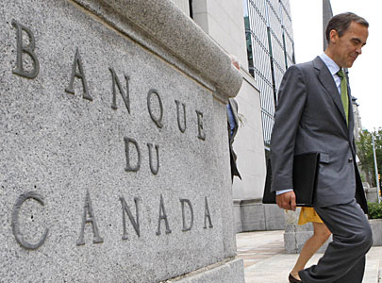
Canada – floating exchange rate regime
Canadian Finance Minister Joe Oliver won't interfere Bank of Canada on exchange rates, as of his interview with Bloomberg.

Slide 10
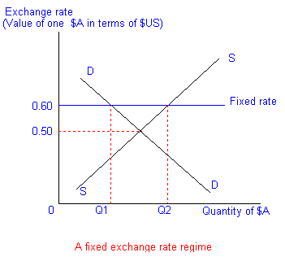
Canada – no action of controlling ER
Bank of Canada has not interfered with Canadian's exchange rate since 1998.

Slide 11
Pros?
Economy > Currency
Flexibility
Automatic movement to equilibrium
Absence of crises
Lower foreign exchange reserves

Slide 12
Cons?
Ambiguity of tomorrow’s exchange rate
Fear for investors as the currency value is a roller coaster.
Inflationary
Allow government to pursue inappropriate actions.

Slide 13
Appreciation
Gain in Canadian dollar’s value as compared to other currencies.

Slide 14
Walmart USA imported 1 ton of maple syrups…
Export & Import
Canadian attractive commodities will attract other countries in buying Canadian dollars to purchase such commodities. Many countries buy Canadian dollars means that Canadian dollar’s demand is rising.

Slide 15
Obtaining a foreign trading license is easier…
Government regulations
When foreign trading license is easier to obtain, Canadian investors will exchange their Canadian dollars for foreign currencies. This will decrease the supply of Canadian dollars in circulation.

Slide 16
Savings account in CAD gives higher interest…
Monetary policies
When savings accounts in Canadian dollars, as compared to other currencies, can earn households or firms more money, they will most likely to exchange their current currency into Canadian dollars for deposits. This is, the demand for Canadian dollars is increasing.

Slide 17
Depreciation
Lost in Canadian dollar’s value as compared to other currencies.

Slide 18
Canadian’s lumber price is increasing…
Export & Import
When Canadian commodities are less attractive, in terms of price, other countries will purchase fewer of such commodities, thus exchange for a fewer amount of Canadian dollars. Many countries decrease their buying of Canadian dollars means that Canadian dollar’s demand is falling.

Slide 19
Bank of Canada prints a new series of CAD…
Government regulations
The action of Bank of Canada printing a new series of Canadian dollar means that they are supply more Canadian dollars into circulation.

Slide 20
Loan account in CAD is charged with a higher interest…
Monetary policies
When loan accounts in Canadian dollars, as compared to other currencies, make households or firms pay more, they will most likely not to choose Canadian dollars as their loan account’s currency. This is, the demand for Canadian dollars is falling.

Slide 21
Consequences?
What if CAD depreciates?

Slide 22
Exports cheaper
Devaluation will decrease the value of your currency against others, meaning that when others purchase your goods and services (or you sell your goods and services to them), they will pay less of their currency, as compared to the past.

Slide 23
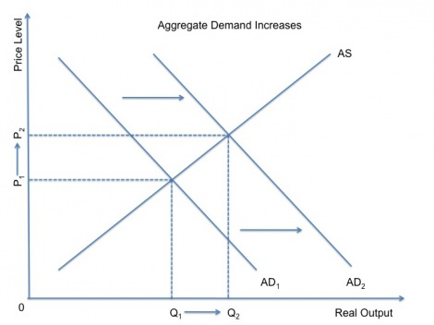
Increase aggregate demand.
Cheaper exports will encourage other countries to purchase/invest in your country’s goods and services. Therefore, as your currency devalues, its aggregate demand is increasing.

Slide 24
Imports more expensive.
Devaluation will decrease the value of your currency against others, meaning that when you purchase others goods and services (or others sell you their goods and services), you will pay more of your currency, as compared to the past.

Slide 25
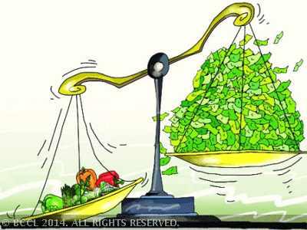
INFLATION!!!
AD rises: if the economy is at full capacity, higher AD will cause inflation.
Imports’ price rises: retail price increases, but retailers earn less profits.
Exports rises: firms have less incentives to cut costs, as they are better off in the market -> long run costs rise and so does inflation.

Slide 26
THE END
Thank you for your attention.

